Slide 1
Portable Sensing Field Device
Group 4:
Joel Yello
Khoa Nguyen
Dawson Brown
Robert Pribyl

Slide 2
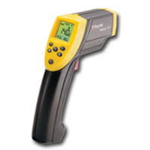
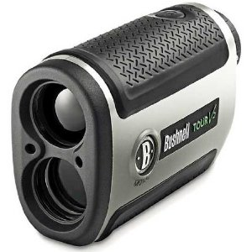
Project Introduction
Laser-Based Rangefinder
IR Contactless Temperature Sensor
Combine both functions into one light-weight, handheld device activated by a trigger.
Provide simultaneous range and temperature readings via a 16x2 LCD output.

Slide 3
Motivation
New to optical systems
Group interest in laser technology and infrared technology
Combines 2 tools used every day
Lightweight
Small form-factor
Easy to read
Low power consumption
Time of Flight ranging is a challenge

Slide 4
Specifications
Ranging from 1-50 meters
+/- 1 meter accuracy in subsequent measurements
Temperature readings from 0-5 meters
+/- 2 degree accuracy in subsequent measurements
Device should weigh no more than 2.5 pounds for portability.
LCD display must switch between temperature and range readings on button press.

Slide 5
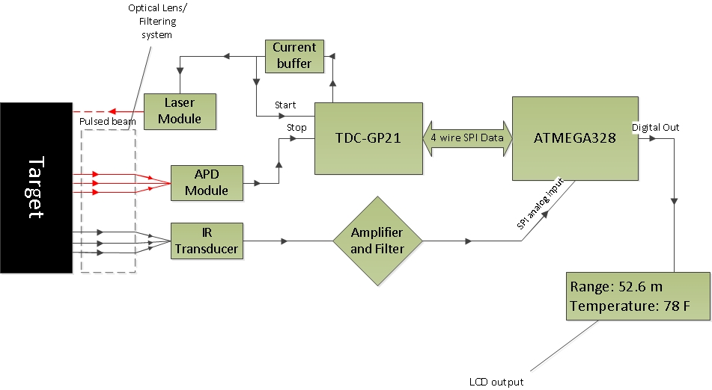
Block Diagram

Slide 6
Power
Each individual part of our device operates in a range between 3.3 and 140 VDC.
Our high voltage supply needs to supply 140 volts. It supplies 400V at 12V, and through testing we have determined it can run 140V at ~5 volts.
Our device must remain portable, meaning we must choose a portable power source (i.e. batteries).
To obtain the different supply voltages to our silicon, our battery sources must be regulated.
Linear regulators are the cheapest and easiest to use for our application.

Slide 7
Power
Our project uses an op-amp that has dual rails, +- 5VDC.
Instead of buying an expensive buck-boost converter to obtain the negative voltage from the same source, we opted to use a secondary source and drive a negative voltage regulator from it.

Slide 8
Source Options
Technology | Cell Voltage | Weight | Price
Nickel Cadmium | 1.2V | ~20g | ~$1 USD
Nickel Metal Hydride | 1.2V | ~28g | ~$1.50 USD
Lithium Ion | 3.6V | ~45g | $5-$10 USD
9V Alkaline | 9V | ~45g | ~$5 USD
Since we must use two batteries, one to supply the positive voltages, and one to supply the negative voltages, we have to consider the price and weight of making a battery pack of individual cells. In the end, two battery packs of any of the first three technologies becomes undesirable. We will use two 9V batteries.

Slide 9
Voltage Regulation
In order to power the different chips we have employed, we have to regulate our 9V sources to lower voltages in order to operate them.
Regulator | Input Voltage | Output Voltage | Output Current
LM7805 | 7-35VDC | 4.8-5.2VDC | Up to 1.2A
LM7905 | -(7-35)VDC | -(4.8-5.2)VDC | Up to 1.2A
LD1117V33 | 4.3-15VDC | 3.267-3.333 | Up to 1.3A

Slide 10
Ranging - Design Considerations

Slide 11
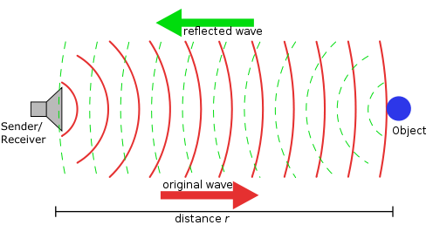
Design Considerations
Methods of Ranging considered
SONAR (ultrasonic)
Cheapest to implement
Easy to use
Distance limited to less than 10m
RADAR
Can achieve very far distance readings
Does not bounce off all objects
LIDAR (Laser\infrared)
Best choice: Line of sight ranging and will reflect at least some light off almost all surfaces.
Our design will use the time of flight method

Slide 12
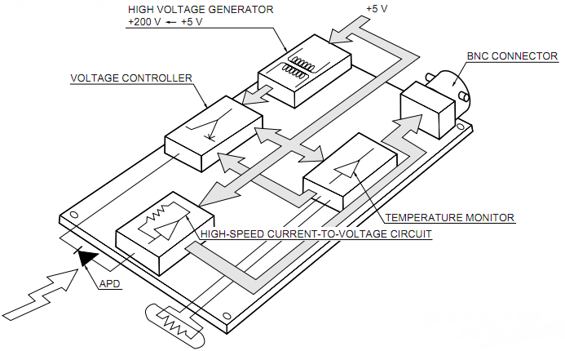
APD Module

Slide 13
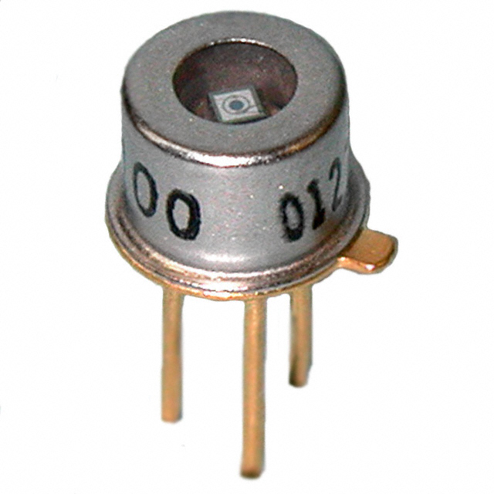
Avalanche Photodiode
Must be operated under high voltage (100V+)
Very sensitive photo-receiver
Advantages include:
Exploits the avalanche multiplication process for added gain
Ideal for a rangefinder
High speed operation
High quantum efficiency
Design considerations:
Terminal capacitance
Sensitive to ambient temperature changes
Exhibit measurable dark current

Slide 14
APD Selection
Main selection aspects included:
Low bias operation
Peak spectral sensitivity
Low price
Max dark current
Temperature coefficient
Selected mid-range Hamamtsu S2381
Manufacturer | Part Number | Active area mm | Peak wavelength (λ) nm | Peak sensitivity (A/W) | Max dark current (nA) | Temperate coefficient (V/°C) | Typical breakdown voltage (V) | Unit Price $
Hamamatsu | S9251-05 | 0.5 | 860 | 0.52 | 2 | 1.85 | 250 | 91.00
Hamamatsu | S9251-02 | 0.2 | 860 | 0.52 | 1 | 1.85 | 250 | 83.00
Hamamatsu | S6045-02 | 0.5 | 800 | 0.5 | 1 | 0.4 | 200 | 100.00
Hamamatsu | S6045-01 | 0.2 | 800 | 0.5 | 0.5 | 0.4 | 200 | 91.00
Hamamatsu | S5139 | 0.5 | 800 | 0.5 | 1 | 0.65 | 150 | 83.00
Hamamatsu | S2383-10 | 1.0 | 800 | 0.5 | 2 | 0.65 | 150 | 136.00
Hamamatsu | S2382 | 0.5 | 800 | 0.5 | 1 | 0.65 | 150 | 83.00
Hamamatsu | S2381 | 0.2 | 800 | 0.5 | 0.5 | 0.65 | 150 | 76.00
Pacific Silicon | TO52-S1 | 0.5 | 900 | 0.6 | 1.5 | 1.55 | 200 | 93.10

Slide 15
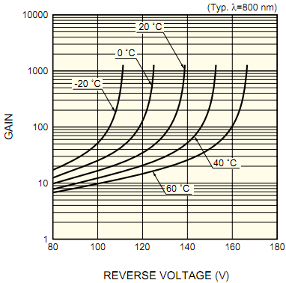
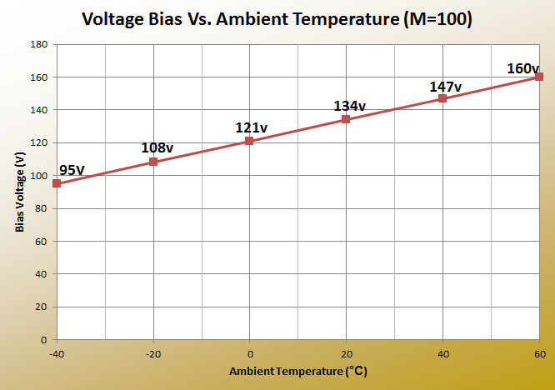
Temperature effects on S2381
As the ambient temperature increases, the voltage required to maintain constant gain must increase.
We are operating with M at 100.

Slide 16

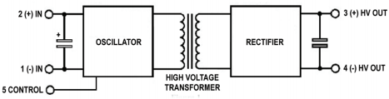
High Voltage DC-DC Converter
Decided to buy pre-made converter instead of building our own due to size goal.
Emco Q04 outputs 60-400V
Maximum output current of 1.25mA
Peak-peak output ripple less than .1%
Draws less than 100mA under full load at 12v input voltage.
As a cube of only 0.5 inches and a weight of just over 4 grams, the Q04 is ideal for portable applications.

Slide 17
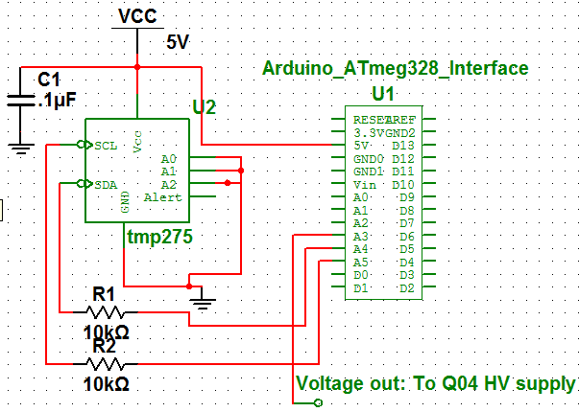
Ambient Temperature Adjust
Control pin on HV supply must be adjusted to maintain constant gain.
Tmp275 – Digital output temperature sensor will be used to detect ambient temperature.
Eight addresses
Two wire serial interface using I2C
Capable of reading temperatures with a resolution of 0.0625°C
Temperature range of -40 to +125°C
As ambient temperature changes, analog output from MCU will change from 0-5V; directly changing the HV output.

Slide 18
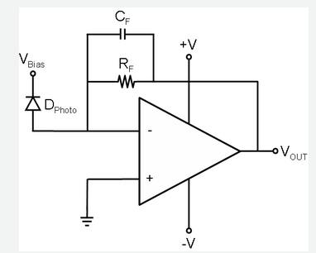


Transimpedance Amplifier
Requirements
Must be very low noise
Must provide acceptable gain
Vo max 5 volts pk-pk
High speed response
TI OPA847
BJT amplifier
High GBP: 3.9GHz
High slew rate 950V/us
Very low voltage noise of 0.85nV/√Hz
Since feedback capacitor is inversely proportional to resistance, an additional gain stage will be needed.

Slide 19
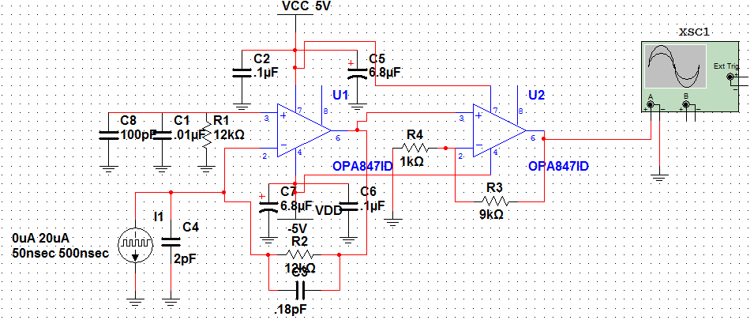

Circuit Schematic
Shown highlighted in yellow is a current source and input capacitance representing the APD.
Boxed in blue is the gain resistor of 12k and feedback capacitance used to control the frequency response.
The red box is the additional op-amp that serves as an extra gain stage to put the output voltage in the range of 1-5V.

Slide 20
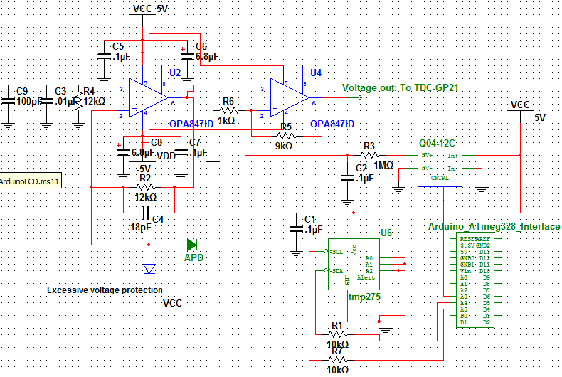
APD Module Schematic

Slide 21
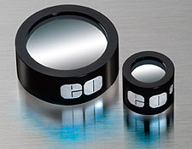
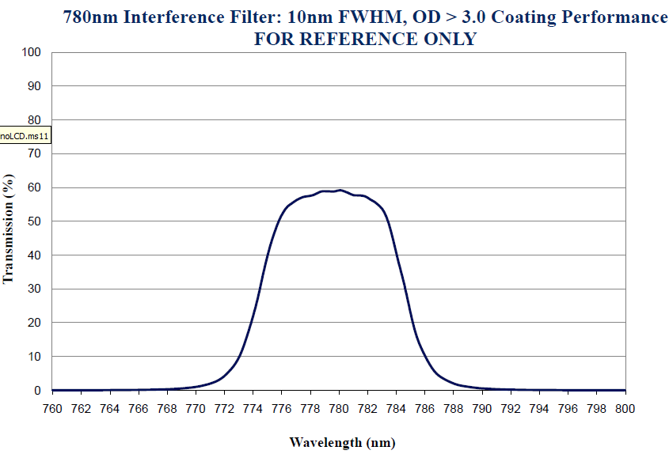
Infrared Optical Filter
Required to block out unwanted wavelengths from entering system.
IR band-pass filter from Edmund optics.
Diameter of 25mm
CWL of 780nm
Same as output laser.
With a Pass-band of only 10nm; the filter is very precise

Slide 22
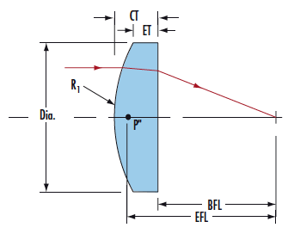
Laser Optics: PCX Lens
Edmund Optics: V-Coated 785nm
Maximum throughput at 785nm
Glass substrate, N-BK7 (RoHS compliant)
125mm Focal Length
Longer Focal Length = More intense focal point

Slide 23
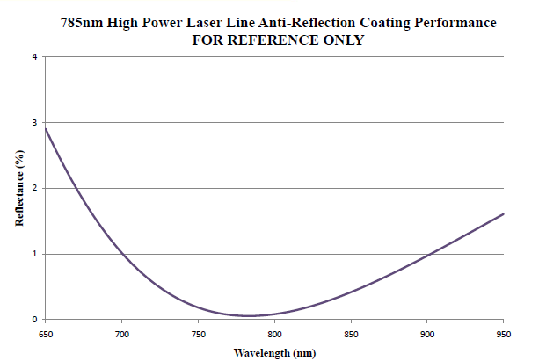

Slide 24
Range Measurement Hardware

Slide 25
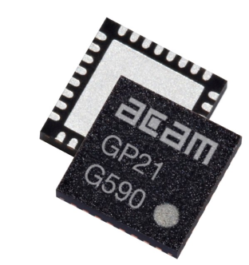
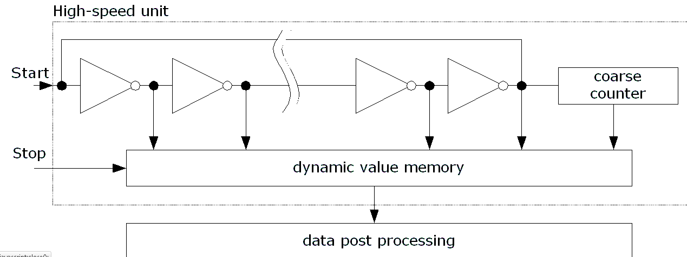
ACAM TDC-GP21
Time to Digital Converter
Measures the time difference between 2 signals
Capable of implementing TOF laser ranging due to redundant circuitry and propagation delays.
Multiple clock signals capable of measuring 3ps intervals (3 mm)
QFN 32 package
SPI communication
Fire Pulse Generator
Output tied to laser module and START channel
Cost effective: $40.00 for a large increase in range

Slide 26
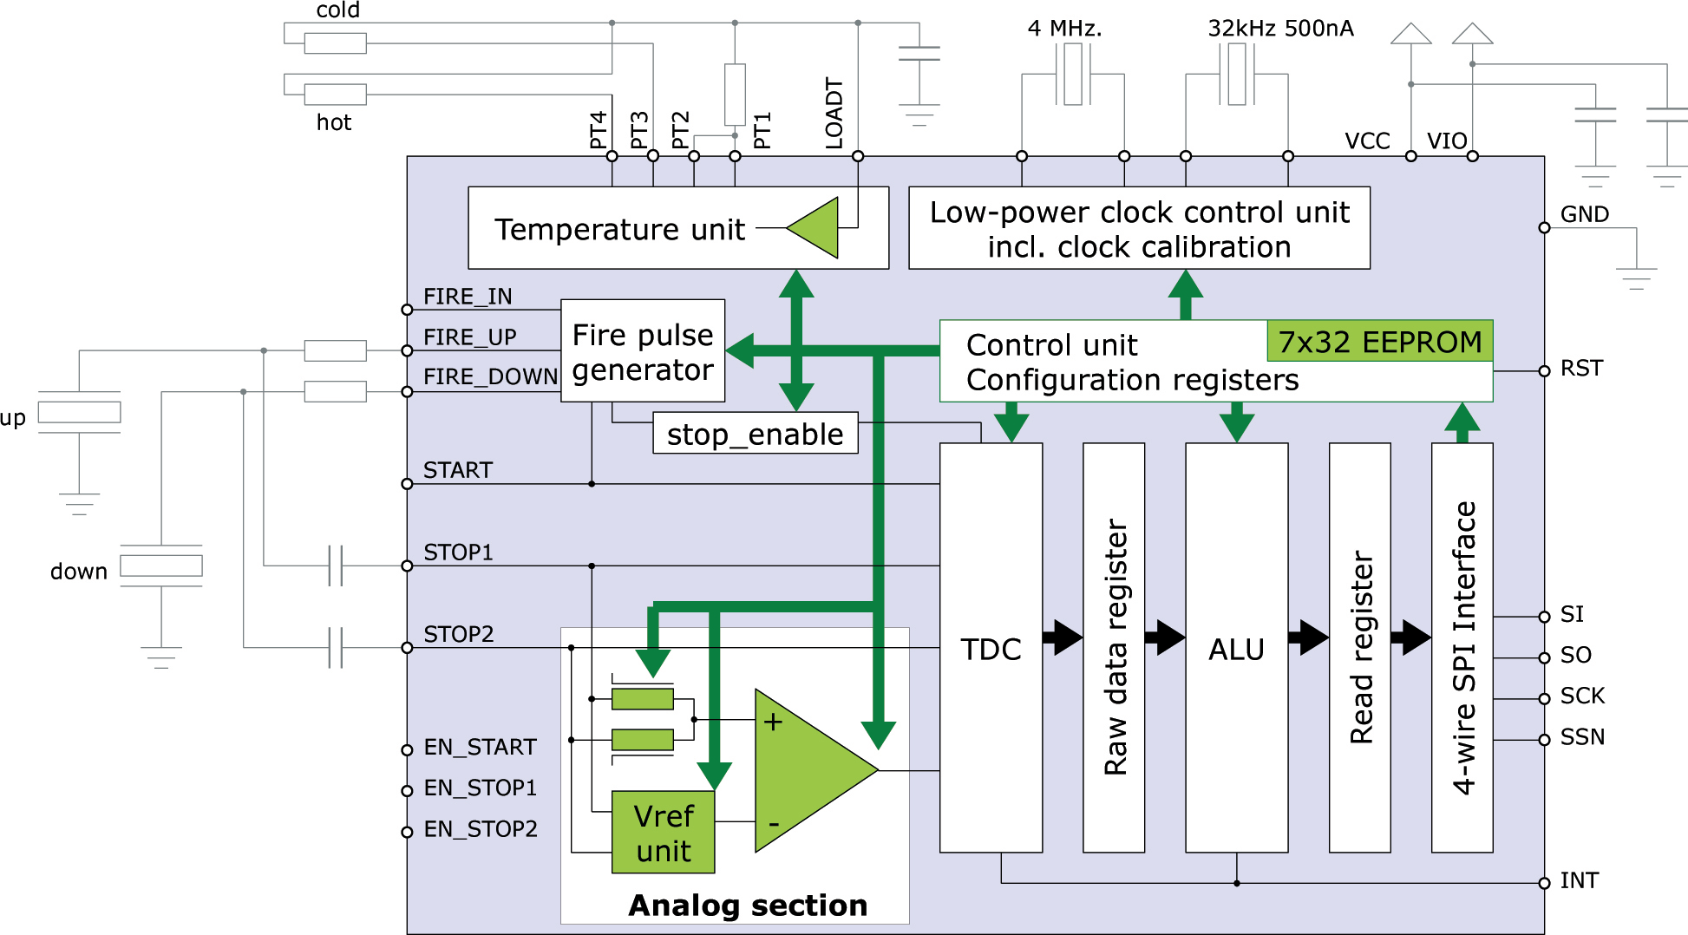
ACAM TDC-GP21

Slide 27
ATmega328 & Arduino Uno Board
13 digital GPIO pins
6 analog input pins
Can serve as digital GPIO
16 MHz Crystal Oscillator
5V and 3.3V output perfect for prototyping
Price: $35.00
SPI and I2C compatible

Slide 28
Arduino Uno Environment
C-based programming
SPI Library (GP21 Communication)
I2C Library (TMP 275 Ambient Temp Sensor)
LCD Library (Hitachi HD 44780)
Extensive Support Community
Online Tutorials
Limitations with SPI communication require new functions to be written

Slide 29
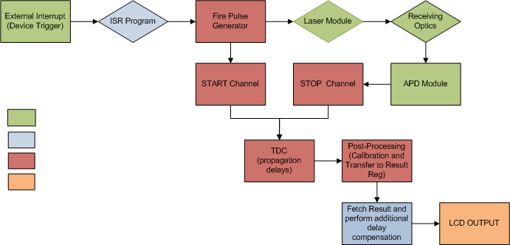
Ranging Process Flow
= External
= ATmega328
= GP21
= LCD

Slide 30
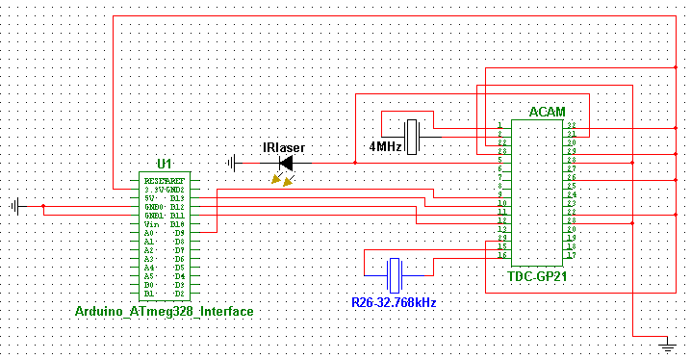
Arduino-GP21 Prototyping
4 Wire SPI connection
Declare new Slave Select Line for GP21
3.3V Supply from Arduino to TDC

Slide 31
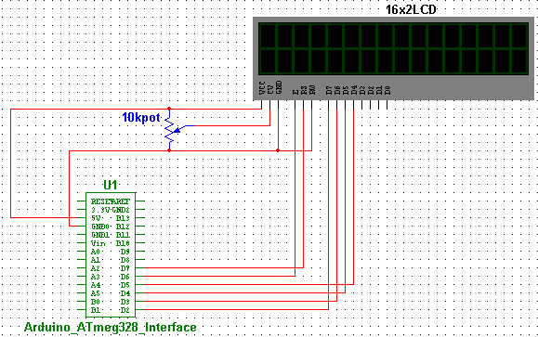
LCD Prototyping
4 Wire interface for data transfer (D2-D5)
2 Wire interface for Enable and R/W configuration (D6-D7)
5V supplied by Arduino to power LCD and backlight

Slide 32
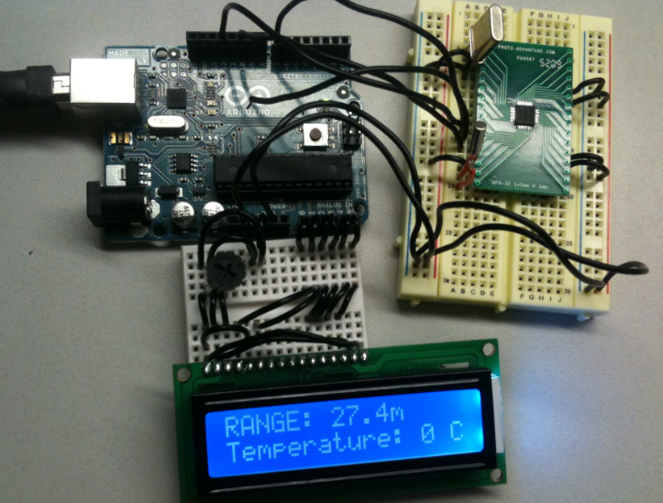
Prototyping GP21, Arduino, LCD
LCD: Fully Functioning
GP21: Re-writing the functions needed to communicate with the registers including:
readReg()
writeReg()
TOeeprom()
FROMeeprom()
readResult()
fetchStatus()

Slide 33
Contactless IR Temperature Sensor

Slide 34
IR Temperature Function
Temperature need to be control and monitor engineering application like cooling, heating, drying, and storage.
Increase ability portable sensing field device by giving temperature measuring function.
Considered methods:
* Mechanical
* Thermo-junctive
* Thermo-resistive
* Infrared radiation
Infrared radiation

Slide 35
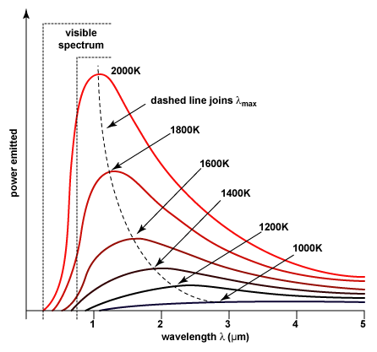
Infrared Radiation - Reasons
Noncontact measurement
Require small energy
Long wavelength –transmitted better through various medium.
It could emit to all kinds of bodies.

Slide 36
Flow Chart
INFRARED SOURCE
DETECTOR
ANALOG TO DIGITAL
LCD DISPLAY
SIGNAL PROCESSING

Slide 37
Detectors
Consider types:
+ Quantum: Expensive
+ Thermal:
Thermocouple
Thermopile
Bolometer
Micro Bolometer
* Thermopile: affordable, small, and accurate
Digital detector : MLX90614
Analog detector: MLX90247 , ZTP – 135SR

Slide 38
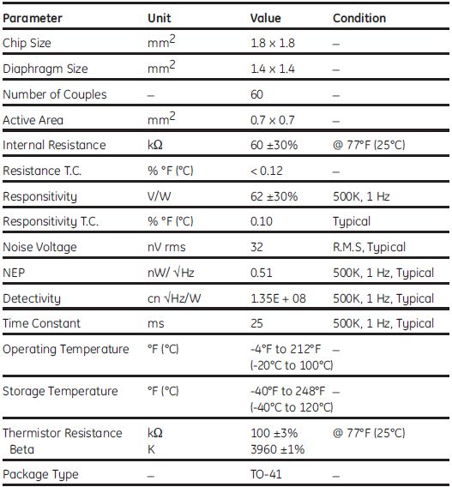
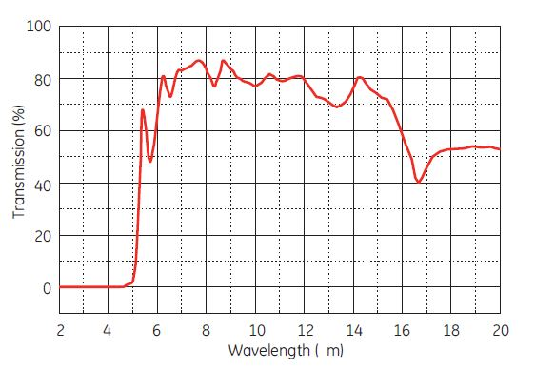
ZTP-135SR
Infrared wavelength: 5 цm to 15 цm

Slide 39
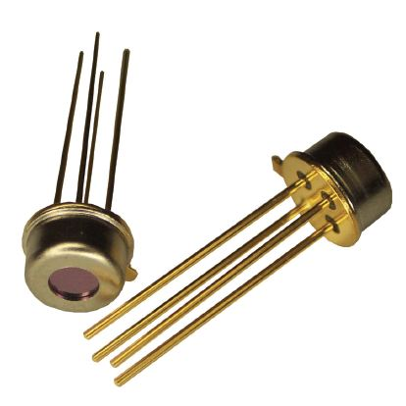
FEATURES
Small-size sensor (TO-46 package)
Included ambient temperature (thermistor) sensor for compensation
High sensitivity
Fast response time
Low cost
Consists of thermo-elements, flat IR filter
Thermistor of temperature compensation in a hermetically-sealed package.
Variety of filters available to help maximize performance in specific applications

Slide 40
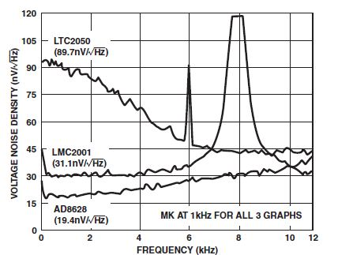
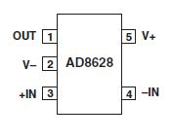
Op-amp Chopper – AD8628
Lowest Auto-zero Amplifier Noise
Low Offset Voltage: 1 цV
Input Offset Drift: 0.02 цV/C
Very Low Input Bias Current:
Low Supply Current: 1.0 mA
Overload Recovery Time: 10 цs
No External Components Required
Rail to Rail Input and Output Swing
5V Single-Supply Operation

Slide 41
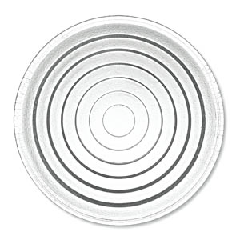
IR Thermometer Optics
Single Fresnel Lens made of HDPE
Salvaged from porch-light lens
Cost-Effective Vs. Germanium or Silicon
Commonly used in low-cost PIR sensors and IR temperature guns

Slide 42
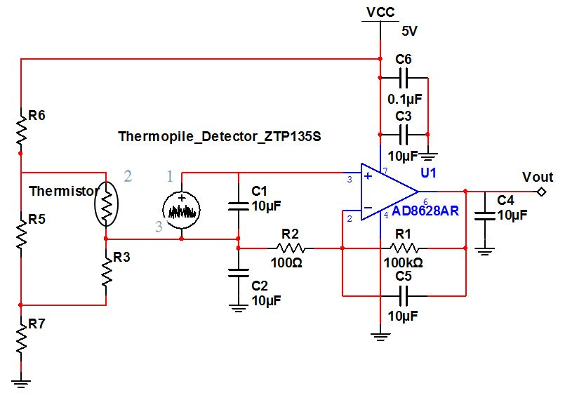
Schematics

Slide 43
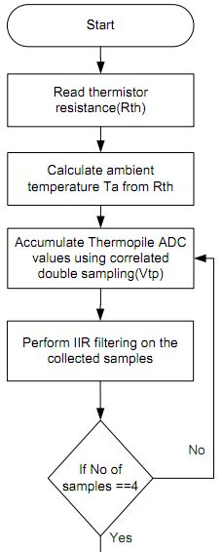
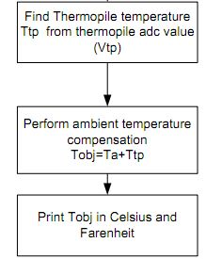
Software Flow

Slide 44
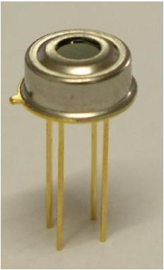
MLX90614
Small size, low cost
High accuracy of 0.5ºC
Range -40ºC to 125ºC ambient temperature 70ºC to 382.19ºC object temperature.
SMBus compatible digital interface
Customizable PWM output for continuous reading
Sleep mode for reduced power consumption

Slide 45
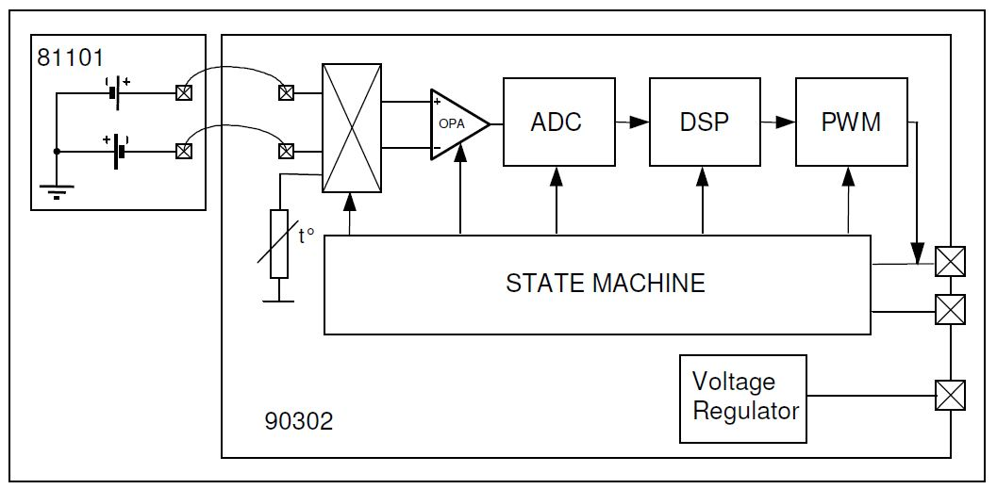
Schematics

Slide 46
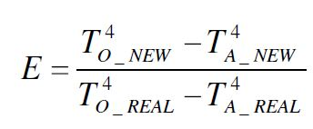

Calibration
Range detect
Fresnel lens
Emissivity
EEPROM
Emissivity 0x04
Base 0x0F
Filter 0x25

Slide 47
Challenges
Frequency stability with of the transimpedance amplifier
Interfacing TDC to APD module
Quantifying the delay of the laser module startup
Properly mounting the lens and filter so that its focal point is on the APD
Possibly using a different LCD for increased user experience
Enclosure issues

Slide 49
Budget to Date
Name | Source | Cost | Purchased?
TDC-GP21 (QFN) | Transducers Direct | $35.00 | yes
Arduino Dev Board: | Element 14 | $30.00 | yes
ATMEGA328
QFN32 Breakout Board | Proto-advantage | $13.99 | yes
780nm Laser Module | Aixiz | $13.00 | yse
16x2 LCD | Spark Fun | $13.95 | yes
Various Resistors | Anywhere | *$5.00 | yes
Various Capacitors | Anywhere | *$5.00 | yes
PCXOptical Lens - NT65-524 | Edmund Optics | $40.00 | yes
780nm Optical Filter - NT65-723 | Edmund Optics | $99.00 | yes
Li-ion 7.4V | Battery Junction | $25.00 | no
LM7805 +5V Regulator | Spark Fun | $1.25 | yes
LM7905 -5V Regulator | Fairchild Semiconductor | $0.60 | yes
LD1117 3.3V Regulator | Spark Fun | $1.95 | yes
MLX90614 | Melexis | $19.95 | yes
Fresnel Lens | N/A | Salvaged | yes
S2381 APD | Hamamatsu | $76.00 | yes
Emco Q04 DC - HV DC | Emco | $59.00 | yes
OPA847 Op-amp x4 | TI | *$10.00 (sampled) | yes
Total |  | $428.69

